Slide 1

12th June Update

Slide 2
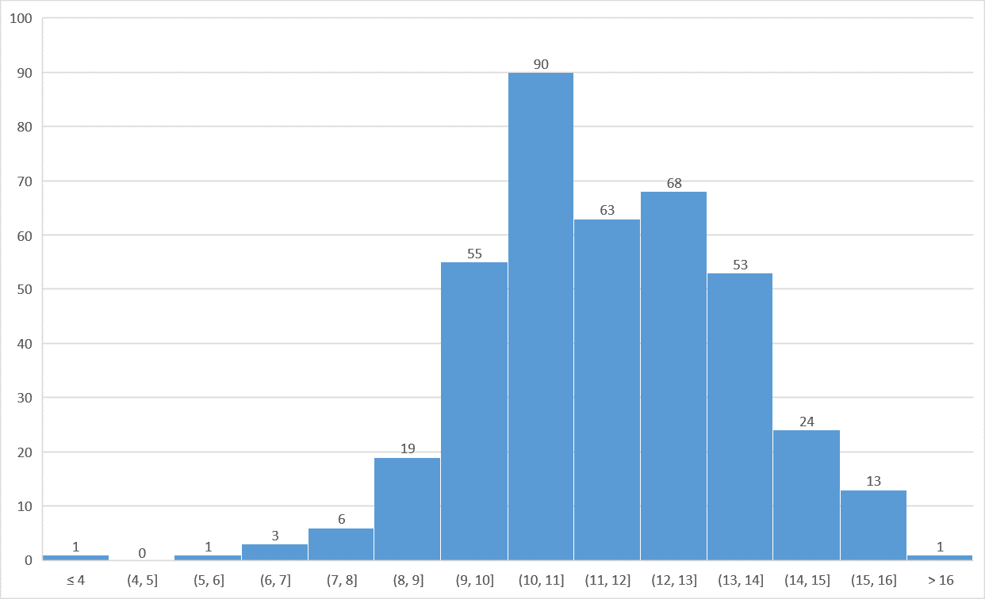
Hemoglobin Distribution
Note: There are 8 people with missing haemoglobin values. There are many incorrect images in individual anatomy, the maximum in eye (14 incorrect images). Therefore out of 426 participants 8 have missing venous blood draw results and 21 patients have incorrect images in respective anatomies which makes total valid participants as 397

Slide 3
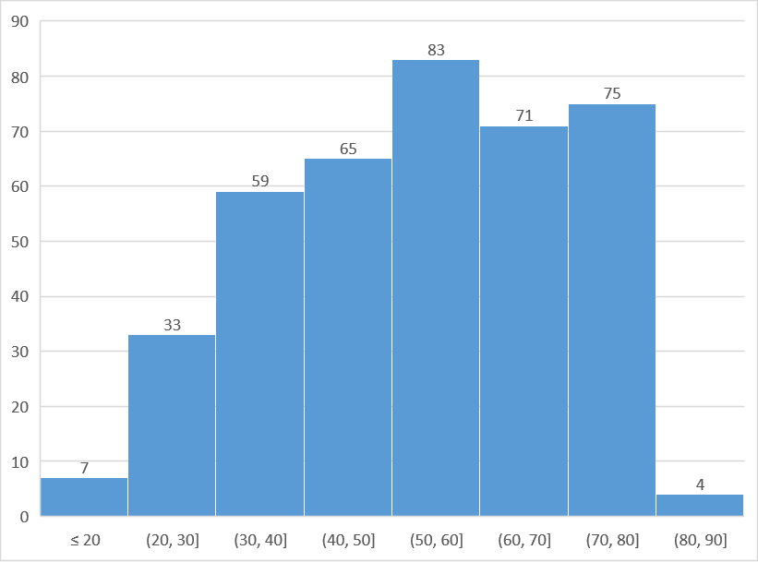
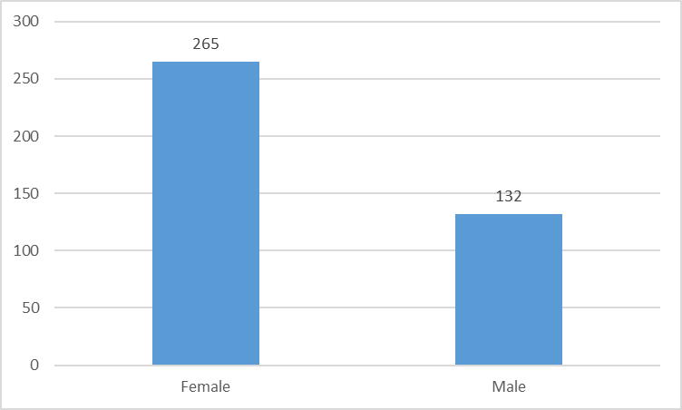
Age and Gender Distribution
Age
Gender

Slide 4
Prakhar Jain et al
Link to paper
Features | mean_r, mean_g | Model | Neural Network
Classification Threshold - 11.5g/dL | Accuracy | Sensitivity | Specificity
Paper (eye) | 97% | 99.21% | 95.42%
Eye | 44% | 29% | 81%
Nail | 54% | 48% | 68%
Palm | 69% | 91% | 25%
Tongue | 53% | 43% | 73%
All | 54% | 46% | 69%
The paper results are better than ours because of the presence of high number of training and testing dataset and due to the difference in data collection method

Slide 5
sHEMO (Sagnik Ghosal et al)
Link to paper
Threshold - 11.5 g/dL
Features | mean_r,mean_g, mean_b |  |  | Model | Logistic Regression*
 | MAE | Accuracy | Precision | Sensitivity | Specificity
Paper (Eye) | 0.323 g/dL | 0.92 | 0.97 | 0.92 | 0.97
Eye | 1.46 g/dL | 0.62 | 0.63 | 0.62 | 0.63
The paper results are better than ours due to the difference in data collection method
* The paper have used the formula Hgb = 7 + 8*(lambda), where lambda is calculated using logistic regression
P.S. - The Hgb values in the paper were between 7 g/dL and 15 g/dL

Slide 6
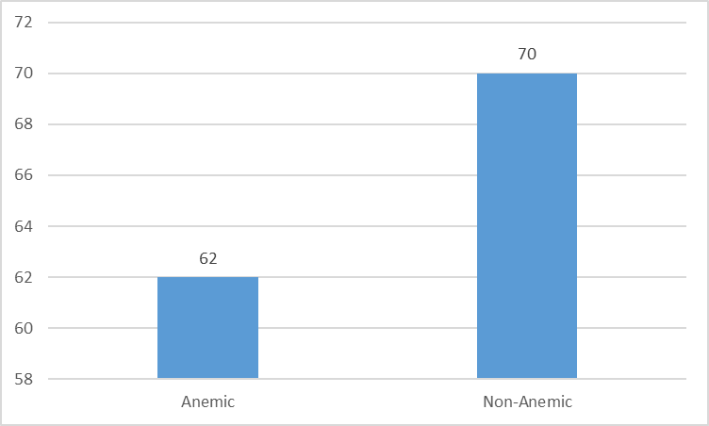
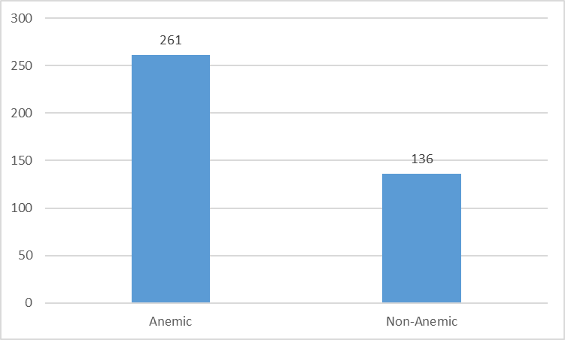
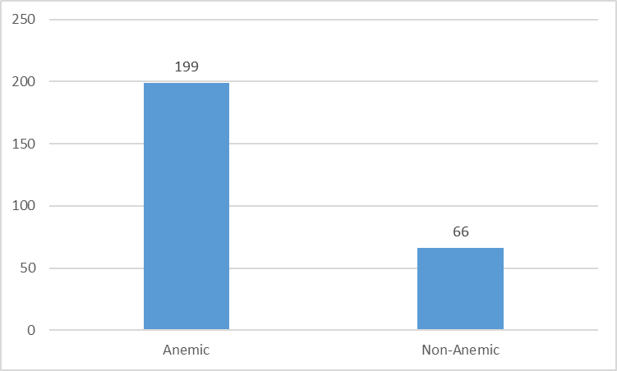
Anemia Distribution
M
A
L
E
(cutoff = 13)
F
E
M
A
L
E
(cutoff = 12)

Slide 7
Classification: Eye (Best)
Algorithm | accuracy | precision | sensitivity | f1 | specificity | roc_auc
Bernoulli Naive Bayes | 0.73 | 0.85 | 0.74 | 0.79 | 0.71 | 0.73
Decision Tree | 0.68 | 0.82 | 0.67 | 0.74 | 0.68 | 0.68
Gaussian Naive Bayes | 0.73 | 0.8 | 0.8 | 0.8 | 0.6 | 0.7
KNN | 0.74 | 0.78 | 0.85 | 0.81 | 0.55 | 0.7
Logistic Regression | 0.78 | 0.79 | 0.9 | 0.84 | 0.51 | 0.71
Neural Network | 0.74 | 0.81 | 0.82 | 0.81 | 0.58 | 0.7
Random Forest | 0.73 | 0.79 | 0.81 | 0.8 | 0.57 | 0.69
SVM | 0.83 | 0.86 | 0.93 | 0.89 | 0.52 | 0.73
The best results for each model are not upto the mark
Male Hb Threshold - 13 g/dL
Female Hb Threshold - 12 g/dL

Slide 8
Classification: Eye (Avg)
Algorithm | accuracy | precision | sensitivity | f1 | specificity | roc_auc
Logistic Regression | 0.7 | 0.72 | 0.87 | 0.79 | 0.35 | 0.62
Neural Network | 0.69 | 0.72 | 0.87 | 0.79 | 0.35 | 0.61
SVM | 0.7 | 0.71 | 0.92 | 0.8 | 0.28 | 0.6
KNN | 0.66 | 0.72 | 0.8 | 0.76 | 0.39 | 0.59
Bernoulli Naive Bayes | 0.65 | 0.71 | 0.82 | 0.75 | 0.34 | 0.58
Gaussian Naive Bayes | 0.62 | 0.72 | 0.7 | 0.7 | 0.47 | 0.58
Decision Tree | 0.58 | 0.7 | 0.64 | 0.67 | 0.47 | 0.56
Random Forest | 0.64 | 0.7 | 0.8 | 0.74 | 0.32 | 0.56
The average results for each model are not upto the mark
*average of 200 runs
Male Hb Threshold - 13 g/dL
Female Hb Threshold - 12 g/dL

Slide 9
Classification: Nail (Best)
Algorithm | accuracy | precision | sensitivity | f1 | specificity | roc_auc
Logistic Regression | 0.77 | 0.85 | 0.83 | 0.84 | 0.61 | 0.72
Neural Network | 0.81 | 0.84 | 0.91 | 0.87 | 0.56 | 0.73
SVM | 0.82 | 0.8 | 0.98 | 0.88 | 0.44 | 0.71
Bernoulli Naive Bayes | 0.72 | 0.87 | 0.74 | 0.8 | 0.69 | 0.71
Gaussian Naive Bayes | 0.74 | 0.8 | 0.81 | 0.81 | 0.61 | 0.71
Random Forest | 0.76 | 0.79 | 0.88 | 0.83 | 0.52 | 0.7
KNN | 0.78 | 0.8 | 0.9 | 0.85 | 0.55 | 0.72
Decision Tree | 0.71 | 0.81 | 0.77 | 0.79 | 0.56 | 0.66
The best results for each model are not upto the mark
Male Hb Threshold - 13 g/dL
Female Hb Threshold - 12 g/dL

Slide 10
Classification: Nail (Avg)
Algorithm | accuracy | precision | sensitivity | f1 | specificity | roc_auc
Logistic Regression | 0.72 | 0.73 | 0.91 | 0.81 | 0.36 | 0.63
Neural Network | 0.72 | 0.73 | 0.91 | 0.81 | 0.36 | 0.63
SVM | 0.71 | 0.72 | 0.92 | 0.8 | 0.31 | 0.61
Bernoulli Naive Bayes | 0.65 | 0.69 | 0.87 | 0.76 | 0.24 | 0.59
Gaussian Naive Bayes | 0.65 | 0.71 | 0.79 | 0.74 | 0.38 | 0.58
Random Forest | 0.66 | 0.71 | 0.84 | 0.76 | 0.32 | 0.58
KNN | 0.67 | 0.72 | 0.83 | 0.77 | 0.36 | 0.56
Decision Tree | 0.56 | 0.69 | 0.62 | 0.65 | 0.46 | 0.54
The average results for each model are not upto the mark
*average of 200 runs
Male Hb Threshold - 13 g/dL
Female Hb Threshold - 12 g/dL

Slide 11
Classification: Palm (Best)
Algorithm | accuracy | precision | sensitivity | f1 | specificity | roc_auc
Logistic Regression | 0.75 | 0.75 | 0.91 | 0.82 | 0.47 | 0.69
Neural Network | 0.77 | 0.82 | 0.84 | 0.83 | 0.62 | 0.73
SVM | 0.76 | 0.74 | 0.95 | 0.83 | 0.43 | 0.69
Bernoulli Naive Bayes | 0.75 | 0.82 | 0.82 | 0.82 | 0.57 | 0.7
Gaussian Naive Bayes | 0.62 | 0.86 | 0.57 | 0.69 | 0.76 | 0.67
Random Forest | 0.72 | 0.79 | 0.82 | 0.8 | 0.53 | 0.67
KNN | 0.73 | 0.76 | 0.87 | 0.81 | 0.48 | 0.67
Decision Tree | 0.7 | 0.8 | 0.72 | 0.76 | 0.66 | 0.69
The best results for each model are not upto the mark
Male Hb Threshold - 13 g/dL
Female Hb Threshold - 12 g/dL

Slide 12
Classification: Palm (Avg)
Algorithm | accuracy | precision | sensitivity | f1 | specificity | roc_auc
SVM | 0.71 | 0.72 | 0.91 | 0.81 | 0.32 | 0.61
Logistic Regression | 0.69 | 0.72 | 0.88 | 0.79 | 0.34 | 0.61
Neural Network | 0.69 | 0.72 | 0.86 | 0.79 | 0.36 | 0.61
KNN | 0.66 | 0.71 | 0.84 | 0.76 | 0.35 | 0.59
Bernoulli Naive Bayes | 0.65 | 0.71 | 0.82 | 0.75 | 0.33 | 0.58
Gaussian Naive Bayes | 0.61 | 0.71 | 0.67 | 0.7 | 0.46 | 0.58
Random Forest | 0.65 | 0.7 | 0.82 | 0.75 | 0.33 | 0.57
Decision Tree | 0.58 | 0.7 | 0.65 | 0.67 | 0.45 | 0.55
The average results for each model are not upto the mark
*average of 200 runs
Male Hb Threshold - 13 g/dL
Female Hb Threshold - 12 g/dL

Slide 13
Classification: Tongue (Best)
Algorithm | accuracy | precision | sensitivity | f1 | specificity | roc_auc
Logistic Regression | 0.79 | 0.83 | 0.88 | 0.86 | 0.57 | 0.73
Neural Network | 0.78 | 0.84 | 0.86 | 0.85 | 0.58 | 0.72
SVM | 0.8 | 0.82 | 0.9 | 0.86 | 0.58 | 0.74
Bernoulli Naive Bayes | 0.7 | 0.82 | 0.74 | 0.78 | 0.61 | 0.67
Gaussian Naive Bayes | 0.72 | 0.82 | 0.77 | 0.8 | 0.62 | 0.7
Random Forest | 0.73 | 0.84 | 0.78 | 0.81 | 0.62 | 0.7
KNN | 0.72 | 0.78 | 0.8 | 0.79 | 0.54 | 0.67
Decision Tree | 0.68 | 0.77 | 0.73 | 0.75 | 0.6 | 0.67
The best results for each model are not upto the mark
Male Hb Threshold - 13 g/dL
Female Hb Threshold - 12 g/dL

Slide 14
Classification: Tongue (Avg)
Algorithm | accuracy | precision | sensitivity | f1 | specificity | roc_auc
Logistic Regression | 0.7 | 0.72 | 0.89 | 0.79 | 0.35 | 0.62
Neural Network | 0.69 | 0.72 | 0.88 | 0.79 | 0.35 | 0.61
Gaussian Naive Bayes | 0.63 | 0.73 | 0.69 | 0.7 | 0.52 | 0.61
SVM | 0.7 | 0.71 | 0.91 | 0.8 | 0.3 | 0.6
KNN | 0.65 | 0.7 | 0.81 | 0.75 | 0.34 | 0.57
Random Forest | 0.63 | 0.7 | 0.79 | 0.74 | 0.34 | 0.56
Bernoulli Naive Bayes | 0.64 | 0.68 | 0.87 | 0.75 | 0.22 | 0.54
Decision Tree | 0.57 | 0.69 | 0.63 | 0.66 | 0.46 | 0.54
The average results for each model are not upto the mark
*average of 200 runs
Male Hb Threshold - 13 g/dL
Female Hb Threshold - 12 g/dL

Slide 15
Classification: Merged (Best)
Algorithm | accuracy | precision | sensitivity | f1 | specificity | roc_auc
Logistic Regression | 0.78 | 0.86 | 0.81 | 0.84 | 0.69 | 0.75
Neural Network | 0.8 | 0.82 | 0.92 | 0.86 | 0.54 | 0.73
SVM | 0.76 | 0.81 | 0.86 | 0.83 | 0.51 | 0.69
Bernoulli Naive Bayes | 0.72 | 0.86 | 0.75 | 0.8 | 0.59 | 0.67
Gaussian Naive Bayes | 0.69 | 0.82 | 0.64 | 0.72 | 0.78 | 0.71
Random Forest | 0.75 | 0.78 | 0.86 | 0.82 | 0.52 | 0.69
KNN | 0.73 | 0.74 | 0.86 | 0.8 | 0.53 | 0.7
Decision Tree | 0.65 | 0.81 | 0.63 | 0.71 | 0.68 | 0.66
The best results for each model are not upto the mark
Male Hb Threshold - 13 g/dL
Female Hb Threshold - 12 g/dL

Slide 16
Classification: Merged (Avg)
Algorithm | accuracy | precision | sensitivity | f1 | specificity | roc_auc
Logistic Regression | 0.69 | 0.73 | 0.85 | 0.78 | 0.41 | 0.63
SVM | 0.7 | 0.71 | 0.91 | 0.8 | 0.31 | 0.61
Neural Network | 0.68 | 0.73 | 0.82 | 0.77 | 0.41 | 0.61
KNN | 0.66 | 0.72 | 0.8 | 0.76 | 0.39 | 0.59
Random Forest | 0.64 | 0.71 | 0.8 | 0.74 | 0.33 | 0.57
Gaussian Naive Bayes | 0.58 | 0.72 | 0.59 | 0.64 | 0.55 | 0.57
Decision Tree | 0.55 | 0.68 | 0.6 | 0.63 | 0.46 | 0.53
Bernoulli Naive Bayes | 0.64 | 0.66 | 0.92 | 0.76 | 0.11 | 0.52
The average results for each model are not upto the mark
*average of 200 runs
Male Hb Threshold - 13 g/dL
Female Hb Threshold - 12 g/dL

Slide 17
Correlation with Hb value
Positive Correlation
Negative Correlation
'Feature 0': 'mean_g_nail',
'Feature 1': 'mean_b_nail',
'Feature 2': 'HHR_nail',
'Feature 3': 'Ent_nail',
'Feature 4': 'B_nail',
'Feature 5': 'G1_nail',
'Feature 6': 'G2_nail',
'Feature 7': 'G3_nail',
'Feature 8': 'G4_nail',
'Feature 9': 'G5_nail',
'Feature 10': 'mean_r_palm',
'Feature 11': 'mean_g_palm',
'Feature 12': 'mean_b_palm',
'Feature 13': 'HHR_palm',
'Feature 14': 'Ent_palm',
'Feature 15': 'B_palm',
'Feature 16': 'G1_palm',
'Feature 17': 'G2_palm',
'Feature 18': 'G3_palm',
'Feature 19': 'G4_palm',
'Feature 20': 'G5_palm',
'Feature 21': 'mean_b_tongue',
'Feature 22': 'HHR_tongue',
'Feature 23': 'Ent_tongue',
'Feature 24': 'mean_r_eye',
'Feature 25': 'mean_rg_eye',
'Feature 26': 'HHR_eye'
'Feature 0': 'gender',
'Feature 1': 'age',
'Feature 2': 'mean_g_eye',
'Feature 3': 'mean_b_eye',
'Feature 4': 'Ent_eye',
'Feature 5': 'B_eye',
'Feature 6': 'G1_eye',
'Feature 7': 'G2_eye',
'Feature 8': 'G3_eye',
'Feature 9': 'G4_eye',
'Feature 10': 'G5_eye',
'Feature 11': 'mean_r_tongue',
'Feature 12': 'mean_g_tongue',
'Feature 13': 'mean_g_tongue',
'Feature 14': 'mean_rg_tongue',
'Feature 15': 'B_tongue',
'Feature 16': 'G1_tongue',
'Feature 17': 'G2_tongue',
'Feature 18': 'G3_tongue',
'Feature 19': 'G4_tongue',
'Feature 20': 'G5_tongue',
'Feature 21': 'mean_rg_palm',
'Feature 22': 'mean_r_nail',
'Feature 23': 'mean_rg_nail'

Slide 18
Classification: Merged (Best)
P
O
S
I
T
V
E
Algorithm | accuracy | precision | sensitivity | f1 | specificity | roc_auc
Logistic Regression | 0.78 | 0.86 | 0.83 | 0.84 | 0.64 | 0.73
Neural Network | 0.71 | 0.73 | 0.86 | 0.79 | 0.44 | 0.65
Gaussian Naive Bayes | 0.65 | 0.8 | 0.64 | 0.71 | 0.67 | 0.65
The best results for top 3 models are not upto the mark
But the negative correlation features are marginally better than the positive
N
E
G
A
T
I
V
E
Algorithm | accuracy | precision | sensitivity | f1 | specificity | roc_auc
Neural Network | 0.78 | 0.82 | 0.88 | 0.85 | 0.59 | 0.73
Logistic Regression | 0.76 | 0.77 | 0.88 | 0.82 | 0.53 | 0.71
Gaussian Naive Bayes | 0.68 | 0.85 | 0.66 | 0.74 | 0.73 | 0.7
Male Hb Threshold - 13 g/dL
Female Hb Threshold - 12 g/dL

Slide 19
Classification: Merged (Avg)
Algorithm | accuracy | precision | sensitivity | f1 | specificity | roc_auc
Logistic Regression | 0.65 | 0.69 | 0.85 | 0.76 | 0.27 | 0.56
Neural Network | 0.63 | 0.69 | 0.8 | 0.73 | 0.31 | 0.56
Random Forest | 0.62 | 0.68 | 0.79 | 0.73 | 0.31 | 0.55
Gaussian Naive Bayes | 0.57 | 0.69 | 0.62 | 0.65 | 0.46 | 0.54
SVM | 0.66 | 0.67 | 0.93 | 0.78 | 0.13 | 0.53
Decision Tree | 0.54 | 0.68 | 0.6 | 0.63 | 0.44 | 0.52
KNN | 0.6 | 0.66 | 0.79 | 0.72 | 0.24 | 0.51
P
O
S
I
T
V
E
The average results for each model are not upto the mark
*average of 200 runs
Male Hb Threshold - 13 g/dL
Female Hb Threshold - 12 g/dL
Only Algorithms with roc_auc>0.5 are considered

Slide 20
Classification: Merged (Avg)
Algorithm | accuracy | precision | sensitivity | f1 | specificity | roc_auc
Logistic Regression | 0.69 | 0.72 | 0.87 | 0.79 | 0.36 | 0.61
Neural Network | 0.68 | 0.72 | 0.86 | 0.78 | 0.34 | 0.6
SVM | 0.7 | 0.71 | 0.91 | 0.81 | 0.28 | 0.59
KNN | 0.65 | 0.71 | 0.8 | 0.75 | 0.38 | 0.59
Gaussian Naive Bayes | 0.61 | 0.72 | 0.69 | 0.69 | 0.47 | 0.58
Bernoulli Naive Bayes | 0.64 | 0.68 | 0.88 | 0.76 | 0.19 | 0.54
Random Forest | 0.62 | 0.67 | 0.81 | 0.73 | 0.27 | 0.54
Decision Tree | 0.57 | 0.69 | 0.64 | 0.66 | 0.43 | 0.53
N
E
G
A
T
I
V
E
The average results for each model are not upto the mark
*average of 200 runs
Male Hb Threshold - 13 g/dL
Female Hb Threshold - 12 g/dL
Only Algorithms with roc_auc>0.5 are considered

Slide 21


Anemia Distribution
Old Cutoff - 11.5 (for both gender)
New Cutoff - 12.33 (for both gender)
 | Total (397) |  | Male (133) |  | Female (267)
 | Anemic | Non-Anemic | Anemic | Non-Anemic | Anemic | Non-Anemic
Original | 261 | 136 | 62 | 70 | 199 | 66
11.5 (Cutoff) | 205 | 192 | 28 | 104 | 177 | 88
12.33 (Cutoff) | 260 | 137 | 43 | 89 | 217 | 48
Original Female Hb Threshold - 12 g/dL
Original Male Hb Threshold - 13 g/dL

Slide 22
Correlation with Hb value
HHR_nail | 0.19 | mean_rg_eye | 0.15 | G3_tongue | 0.07
G4_palm | 0.19 | Ent_tongue | 0.14 | B_palm | 0.06
HHR_eye | 0.18 | mean_b_palm | 0.12 | G5_palm | 0.06
Ent_palm | 0.16 | HHR_tongue | 0.12 | G2_nail | 0.05
G3_palm | 0.16 | G2_palm | 0.11 | G4_nail | 0.05
Ent_nail | 0.15 | G3_nail | 0.08 | mean_g_palm | 0.05
HHR_palm | 0.15 | mean_b_nail | 0.07 | mean_r_palm | 0.04
G1_palm | 0.15 | G1_nail | 0.07 | B_nail | 0*
 |  |  |  | G5_nail | 0*
Positive Correlation
(pearson correlation values)
*values are just greater than zero

Slide 23
Correlation with Hb value
gender | -0.5 | B_eye | -0.09 | G3_eye | -0.06
mean_r_tongue | -0.18 | G5_eye | -0.09 | G2_tongue | -0.06
age | -0.16 | G4_eye | -0.08 | Ent_eye | -0.04
B_tongue | -0.15 | G1_tongue | -0.08 | mean_rg_nail | -0.03
G5_tongue | -0.15 | mean_b_eye | -0.07 | mean_r_nail | -0.02
mean_g_eye | -0.14 | G2_eye | -0.07 | G4_tongue | -0.01
mean_g_tongue | -0.12 | mean_rg_tongue | -0.07 | mean_rg_palm | -0.01
mean_b_tongue | -0.1 | G1_eye | -0.06 | mean_r_eye | 0*
 |  |  |  | mean_g_nail | 0*
Negative Correlation
(pearson correlation values)
*values are just less than zero

Slide 24
Regression : Merged (Best)
Algorithm | mae | r2 | accuracy | precision | sensitivity | f1 | specificity | roc_auc
RandomForest | 1.52 | 0.04 | 0.78 | 0.8 | 0.89 | 0.84 | 0.55 | 0.72
Kernel Ridge | 1.55 | -0.49 | 0.72 | 0.82 | 0.74 | 0.78 | 0.69 | 0.72
CatBoost | 1.43 | -0.03 | 0.74 | 0.82 | 0.81 | 0.82 | 0.57 | 0.69
LGBM | 1.32 | -0.01 | 0.76 | 0.78 | 0.89 | 0.83 | 0.47 | 0.68
P
O
S
I
T
V
E
The best results for top 3 models are not upto the mark
But the negative correlation features are marginally better than the positive
N
E
G
A
T
I
V
E
Algorithm | mae | r2 | accuracy | precision | sensitivity | f1 | specificity | roc_auc
Bayesian Ridge | 1.12 | 0.38 | 0.83 | 0.84 | 0.92 | 0.88 | 0.67 | 0.8
XGBoost | 1.35 | 0.19 | 0.81 | 0.87 | 0.84 | 0.85 | 0.76 | 0.8
SVM Regression | 1.36 | 0.19 | 0.81 | 0.88 | 0.83 | 0.86 | 0.76 | 0.8
Acceptable MAE cutoff is 0.5 g/dL
Hb Threshold 12.33 g/dL

Slide 25
Regression : Merged (Avg)
Algorithm | mae | r2 | accuracy | precision | sensitivity | f1 | specificity | roc_auc
SVM Regression | 1.48 | 0.02 | 0.67 | 0.7 | 0.89 | 0.78 | 0.28 | 0.59
Linear Regression | 1.59 | -0.13 | 0.64 | 0.72 | 0.76 | 0.73 | 0.41 | 0.59
RandomForest | 1.5 | 0 | 0.67 | 0.7 | 0.86 | 0.77 | 0.3 | 0.58
CatBoost | 1.5 | -0.05 | 0.66 | 0.7 | 0.85 | 0.76 | 0.31 | 0.58
Kernel Ridge | 2 | -0.84 | 0.61 | 0.72 | 0.68 | 0.69 | 0.48 | 0.58
Bayesian Ridge | 1.47 | 0.05 | 0.67 | 0.69 | 0.92 | 0.78 | 0.22 | 0.57
LGBM | 1.57 | -0.16 | 0.63 | 0.71 | 0.76 | 0.73 | 0.38 | 0.57
Gradient Boost | 1.6 | -0.2 | 0.63 | 0.71 | 0.75 | 0.72 | 0.4 | 0.57
Neural Network | 1.87 | -0.62 | 0.61 | 0.71 | 0.7 | 0.7 | 0.44 | 0.57
knn | 1.55 | -0.12 | 0.65 | 0.68 | 0.88 | 0.77 | 0.23 | 0.55
XGBoost | 1.6 | -0.19 | 0.62 | 0.69 | 0.78 | 0.73 | 0.33 | 0.55
P
O
S
I
T
V
E
The average results for each model are not upto the mark
Acceptable MAE cutoff is 0.5 g/dL
Hb Threshold 12.33 g/dL
Only Algorithms with roc_auc>0.5 are considered
*average of 200 runs

Slide 26
Regression : Merged (Avg)
Algorithm | mae | r2 | accuracy | precision | sensitivity | f1 | specificity | roc_auc
Bayesian Ridge | 1.27 | 0.23 | 0.76 | 0.79 | 0.86 | 0.82 | 0.57 | 0.71
SVM Regression | 1.28 | 0.22 | 0.75 | 0.77 | 0.88 | 0.82 | 0.51 | 0.69
RandomForest | 1.29 | 0.21 | 0.76 | 0.76 | 0.91 | 0.83 | 0.47 | 0.69
knn | 1.36 | 0.12 | 0.74 | 0.77 | 0.87 | 0.81 | 0.5 | 0.69
LGBM | 1.38 | 0.12 | 0.75 | 0.76 | 0.89 | 0.82 | 0.49 | 0.69
CatBoost | 1.34 | 0.15 | 0.75 | 0.76 | 0.91 | 0.83 | 0.45 | 0.68
Gradient Boost | 1.38 | 0.09 | 0.75 | 0.76 | 0.89 | 0.82 | 0.46 | 0.68
XGBoost | 1.41 | 0.03 | 0.74 | 0.76 | 0.89 | 0.82 | 0.46 | 0.68
Kernel Ridge | 2.1 | -1.15 | 0.62 | 0.69 | 0.8 | 0.72 | 0.28 | 0.54
N
E
G
A
T
I
V
E
The average results for each model are not upto the mark
*average of 200 runs
Acceptable MAE cutoff is 0.5 g/dL
Hb Threshold 12.33 g/dL
Only Algorithms with roc_auc>0.5 are considered

Slide 27
Regression : Merged (Best)
All Features are considered here
Algorithm | mae | r2 | accuracy | precision | sensitivity | f1 | specificity | roc_auc
CatBoost | 1.18 | 0.37 | 0.88 | 0.88 | 0.94 | 0.91 | 0.76 | 0.85
SVM Regression | 1.16 | 0.34 | 0.87 | 0.88 | 0.94 | 0.91 | 0.69 | 0.82
RandomForest | 1.3 | 0.32 | 0.85 | 0.85 | 0.94 | 0.89 | 0.7 | 0.82
knn | 1.34 | 0.2 | 0.84 | 0.89 | 0.88 | 0.88 | 0.76 | 0.82
RandomForest | 1.15 | 0.43 | 0.86 | 0.87 | 0.94 | 0.9 | 0.68 | 0.81
The best results for Top 5 models is good but on average the results are not upto the mark
Acceptable MAE cutoff is 0.5 g/dL
Hb Threshold 12.33 g/dL

Slide 28
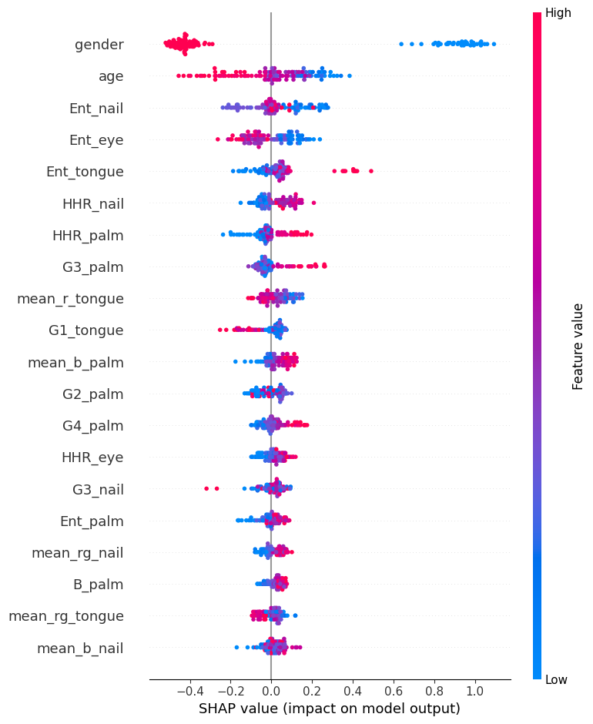
Feature Importance
The top 3 features are
gender
age
Ent nail
CatBoost

Slide 29
Regression : Merged (Avg)
Algorithm | mae | r2 | accuracy | precision | sensitivity | f1 | specificity | roc_auc
Bayesian Ridge | 1.25 | 0.25 | 0.77 | 0.79 | 0.89 | 0.83 | 0.55 | 0.72
SVM Regression | 1.26 | 0.25 | 0.77 | 0.78 | 0.91 | 0.84 | 0.51 | 0.71
RandomForest | 1.27 | 0.21 | 0.77 | 0.78 | 0.9 | 0.83 | 0.51 | 0.71
knn | 1.33 | 0.13 | 0.76 | 0.78 | 0.88 | 0.83 | 0.53 | 0.71
CatBoost | 1.29 | 0.21 | 0.77 | 0.77 | 0.92 | 0.84 | 0.49 | 0.7
LGBM | 1.33 | 0.15 | 0.76 | 0.77 | 0.9 | 0.83 | 0.49 | 0.69
Gradient Boost | 1.35 | 0.11 | 0.75 | 0.77 | 0.88 | 0.82 | 0.5 | 0.69
XGBoost | 1.37 | 0.1 | 0.74 | 0.76 | 0.89 | 0.82 | 0.48 | 0.68
Kernel Ridge | 1.8 | -0.53 | 0.66 | 0.73 | 0.79 | 0.75 | 0.42 | 0.61
Neural Network | 1.95 | -0.71 | 0.57 | 0.68 | 0.66 | 0.66 | 0.41 | 0.54
All Features are considered here
Acceptable MAE cutoff is 0.5 g/dL
Hb Threshold 12.33 g/dL
Only Algorithms with roc_auc>0.5 are considered
*average of 200 runs

Slide 30
Regression : Merged (Best)
All Features (except gender) are considered here
Algorithm | mae | r2 | accuracy | precision | sensitivity | f1 | specificity | roc_auc
SVM Regression | 1.64 | 0 | 0.75 | 0.8 | 0.82 | 0.81 | 0.62 | 0.72
XGBoost | 1.57 | -0.12 | 0.76 | 0.82 | 0.83 | 0.83 | 0.58 | 0.71
RandomForest | 1.35 | 0.04 | 0.75 | 0.83 | 0.81 | 0.82 | 0.62 | 0.71
The best results for top 3 models are not upto the mark
Acceptable MAE cutoff is 0.5 g/dL
Hb Threshold 12.33 g/dL

Slide 31
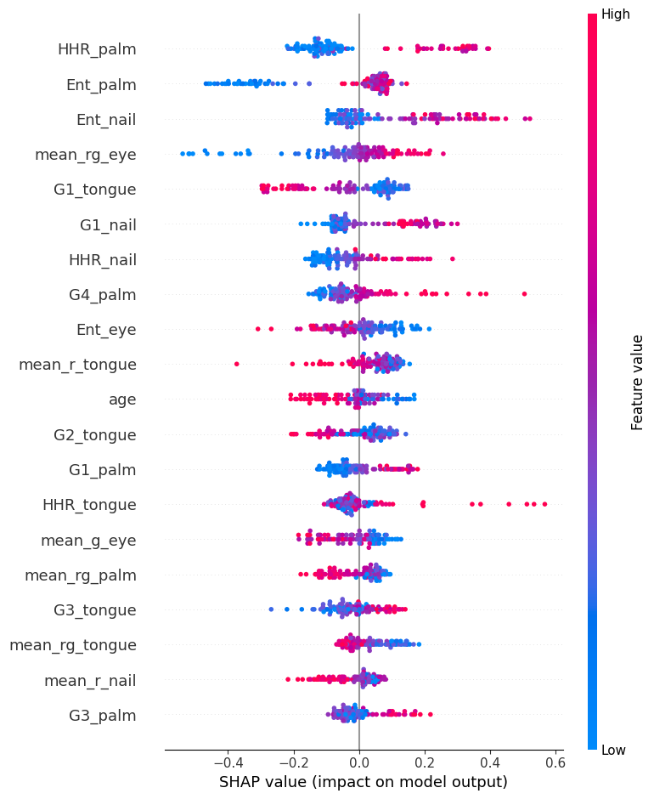
Feature Importance
The top 3 features are
HHR palm
Ent palm
Ent nail
SVM

Slide 32
Regression : Merged (Avg)
All Features (except gender) are considered here
Algorithm | mae | r2 | accuracy | precision | sensitivity | f1 | specificity | roc_auc
Bayesian Ridge | 1.44 | 0.07 | 0.68 | 0.71 | 0.87 | 0.78 | 0.32 | 0.60
CatBoost | 1.47 | 0.00 | 0.67 | 0.70 | 0.87 | 0.77 | 0.30 | 0.58
RandomForest | 1.47 | 0.02 | 0.67 | 0.69 | 0.90 | 0.78 | 0.25 | 0.57
SVM Regression | 1.46 | 0.06 | 0.68 | 0.71 | 0.88 | 0.78 | 0.31 | 0.60
The average results for each model are not upto the mark
Acceptable MAE cutoff is 0.5 g/dL
Hb Threshold 12.33 g/dL
Only Algorithms with r2 non-negative are considered
*average of 200 runs

Slide 33
Moving Forward
Standardization of images to get better feature values

